Slide 1
EDS Reader Guide
Joseph Kern
September 14th, 2020
Email: jkern34@gatech.edu

Slide 2
Uses of EDS Program
(1) Produce intensity-scaled and color-coordinated EDS maps for all elements.
(2) Extract EDS line profiles at arbitrary orientations and with varying averaging widths.
(3) Extract elemental concentrations from arbitrarily drawn regions of interest (ROIs).
(4) Select a subset of elements to plot for quick comparison of results.
(5) Produce Dominant element and dominant oxide maps.
(6) Carry out threshold mapping to determine regions containing singular elements or combinations of 2 or 3 elements between certain thresholds.
(7) The program can automatically switch between At% and Wt%

Slide 3
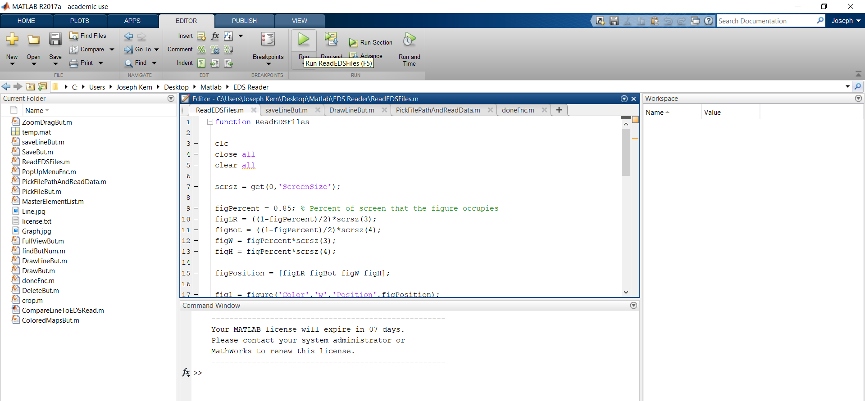
Open Matlab and the “ReadEDSFiles” file. Press Run

Slide 4
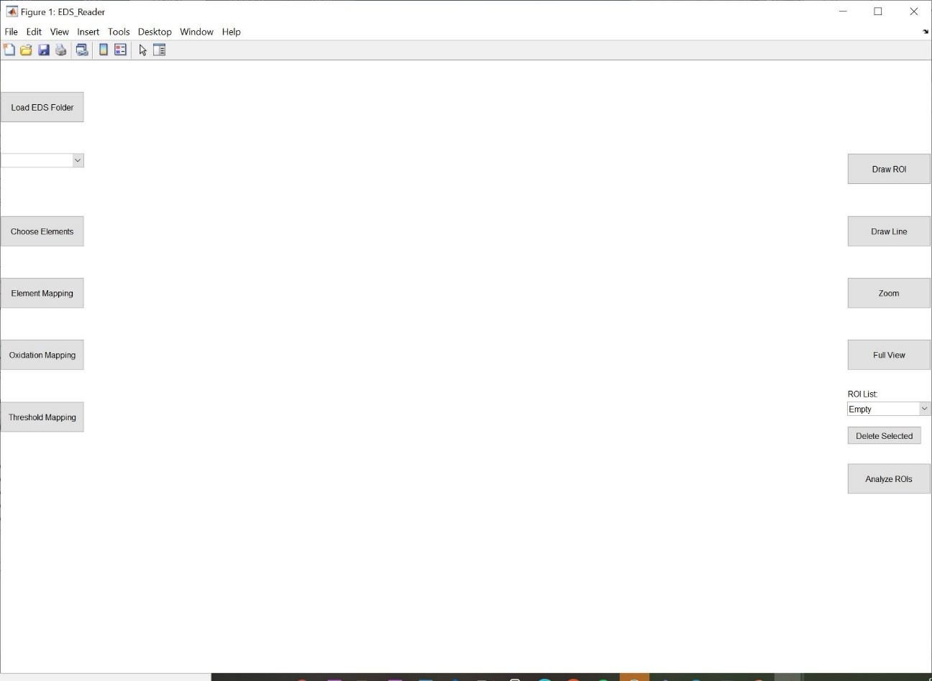
Press the “Load EDS folder” button

Slide 5
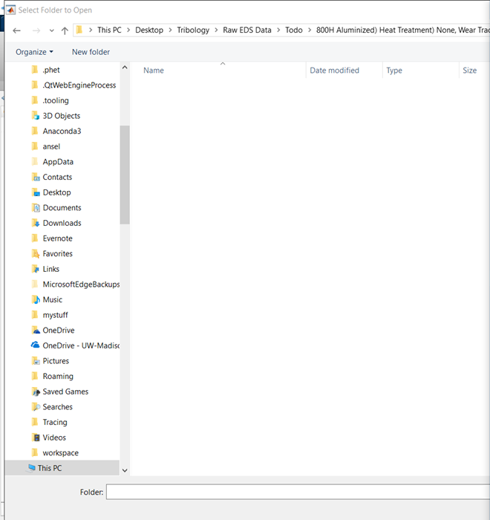
Choose the folder containing the CSV files you are interested in

Slide 6
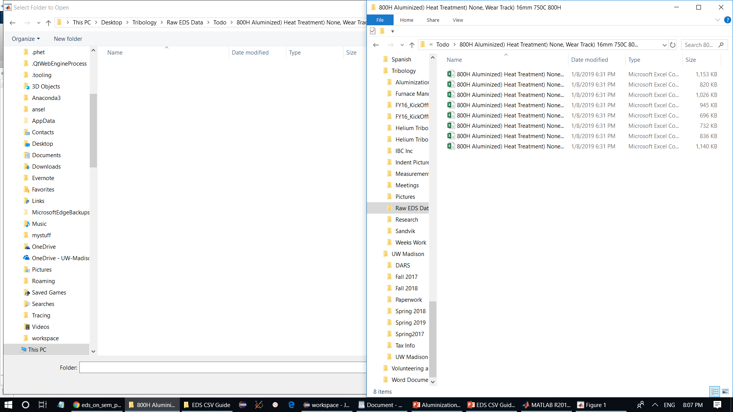
The folder looks empty when you open it, but the CSV files are in there

Slide 7
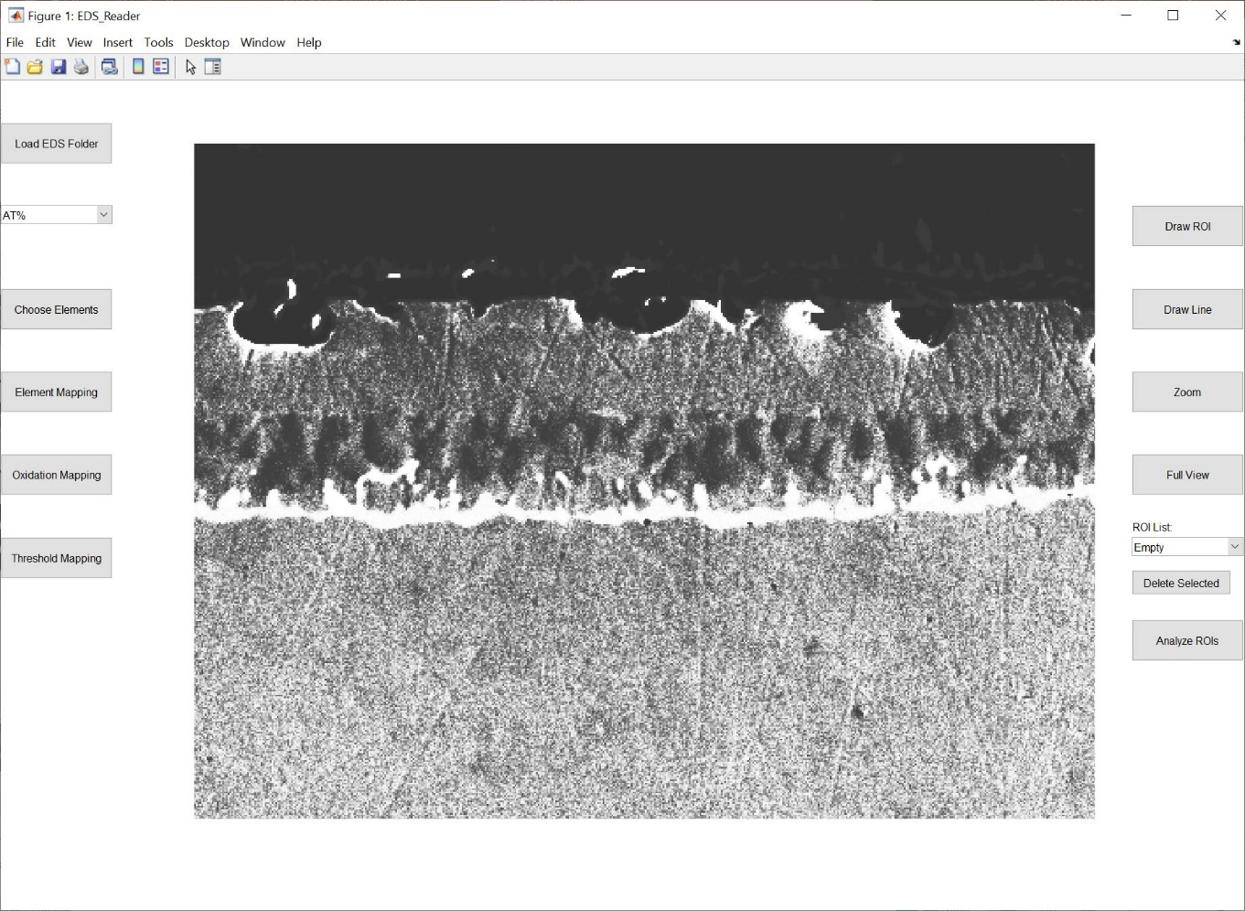
The grey image of your sample will now show up

Slide 8
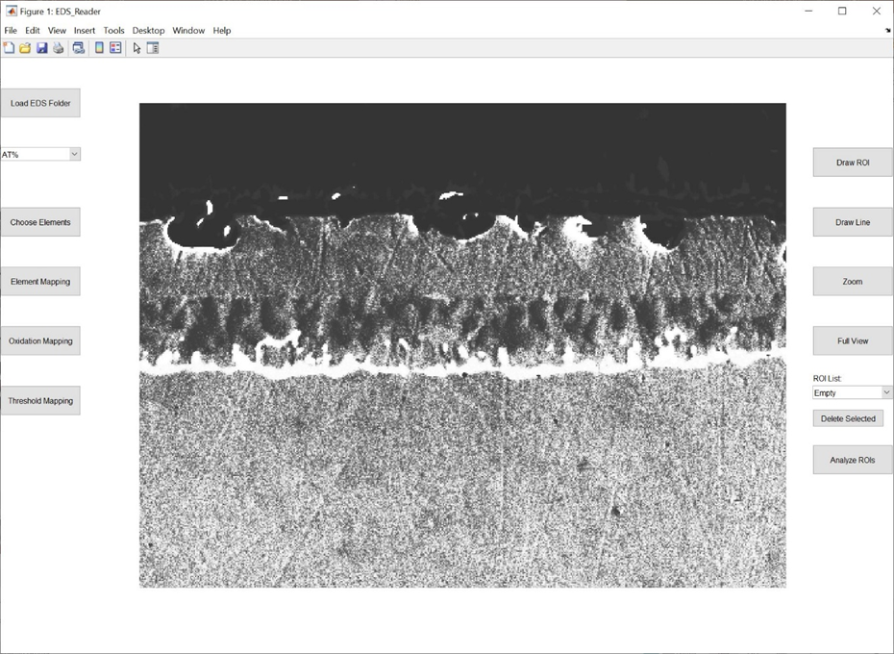
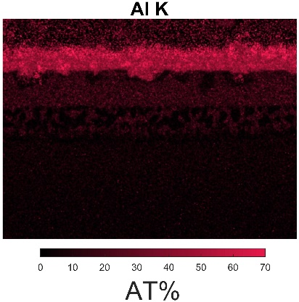
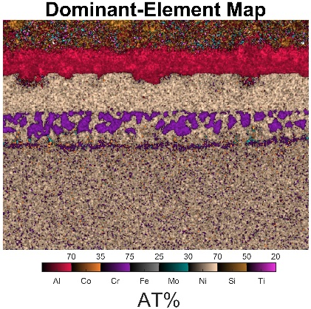
Press the “Element Mapping” button to create colored EDS maps and dominant element maps.
Note: All colored maps are saved to a “coloredMaps_(AT/WT)%” directory in your CSV folder.

Slide 9
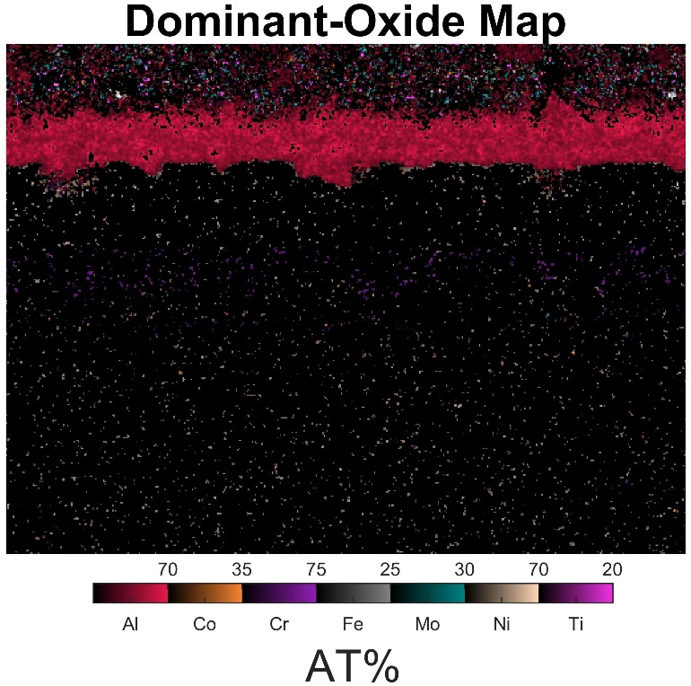
Press the “Oxidation Mapping” button to create EDS oxide maps.
Note: All colored maps are saved to a “coloredMaps_(AT/WT)%” directory in your CSV folder.

Slide 10
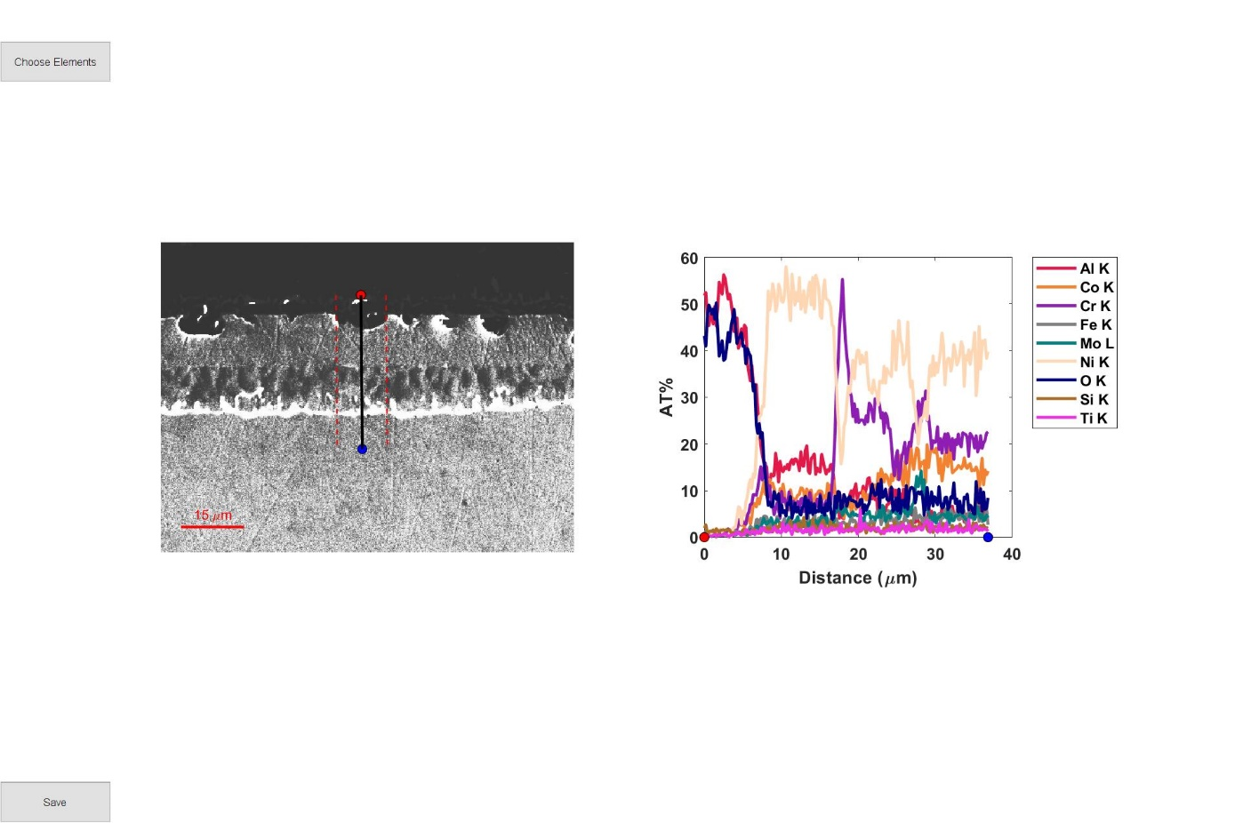
Press the “draw line” button to do a line scan of your image. You can average the line scan over an area by using the arrow keys. Up and down respectively multiply and divide by 2, right and left respectively increment and decrement by 1. Averaged area is the area between the two red, dashed lines.

Slide 11

Elements that are desired for line graphing can be selected with the “Choose Elements” button. All data will still be saved for the excluded element compositions.
Note: All LineScans are saved in a LineScan sub-directory of your CSV folder, along with their data

Slide 12
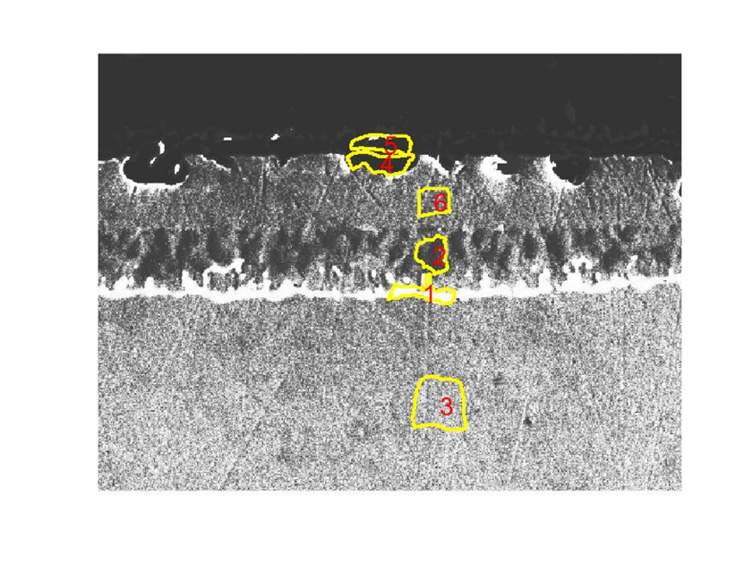
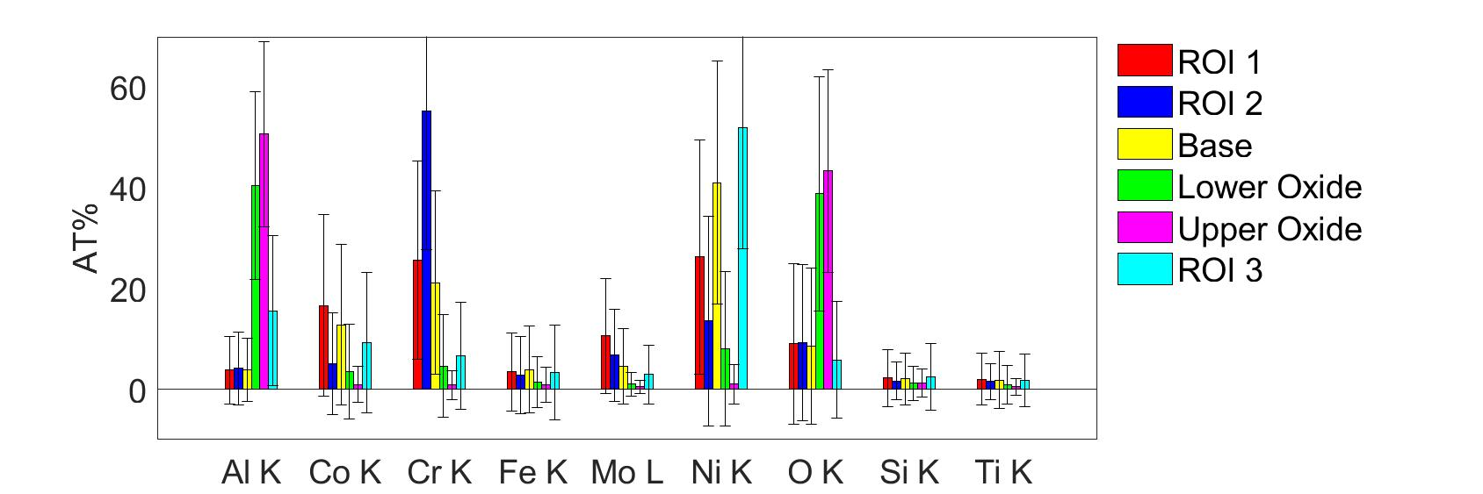
Press the “draw ROI” button and draw shapes on the image that you want to analyze. You can name the shapes whatever you want. Press “Analyze ROIs” to save the data and create a bar chart of the regions. The names will be displayed in sequential order from the top of the legend to the bottom, and will be numbered in the image (1: ROI 1, 2: ROI 2, 3: Base, 4: Lower Oxide, 5: Upper Oxide, 6: ROI 3). ROIs can be deleted with the “delete selected” button.
Note: All bar chart and bar chart data is saved in CSV format in a sub-directory of your CSV folder

Slide 13
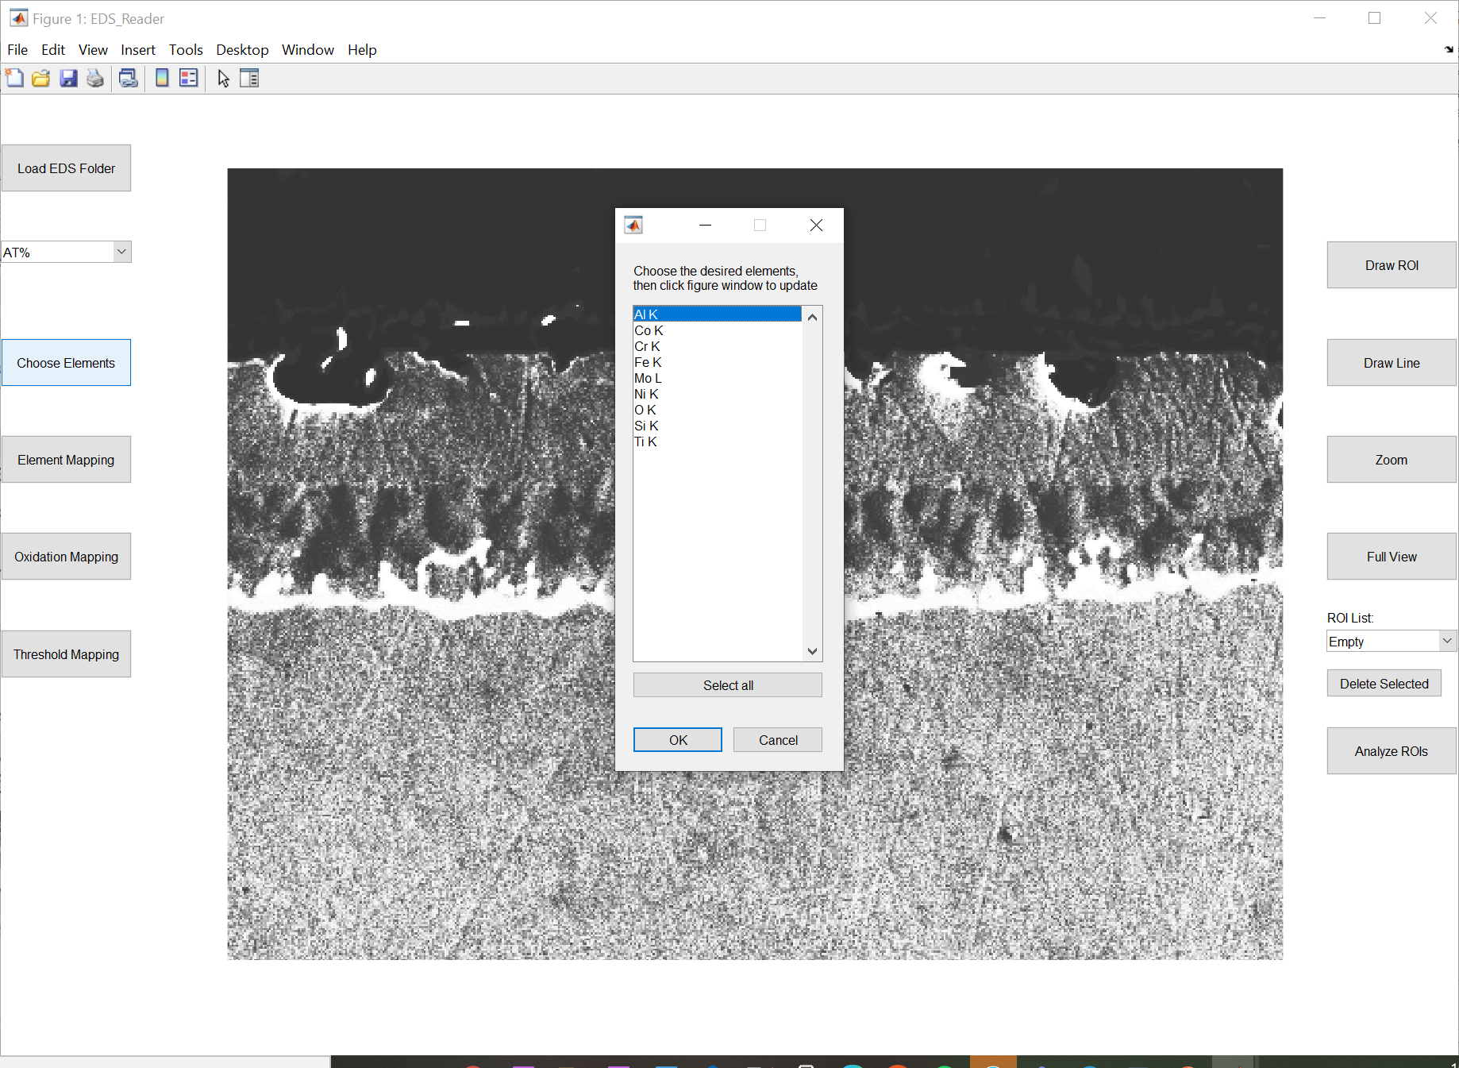
Elements that are desired for bar charts or dominant/oxidation element maps can be selected with the “Choose Elements” button. All data will still be saved for the excluded element compositions.

Slide 14
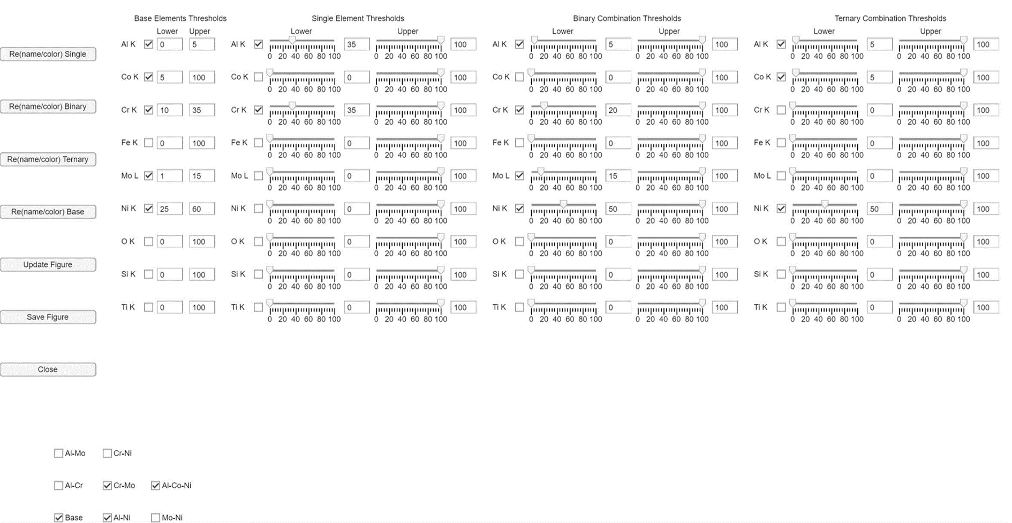
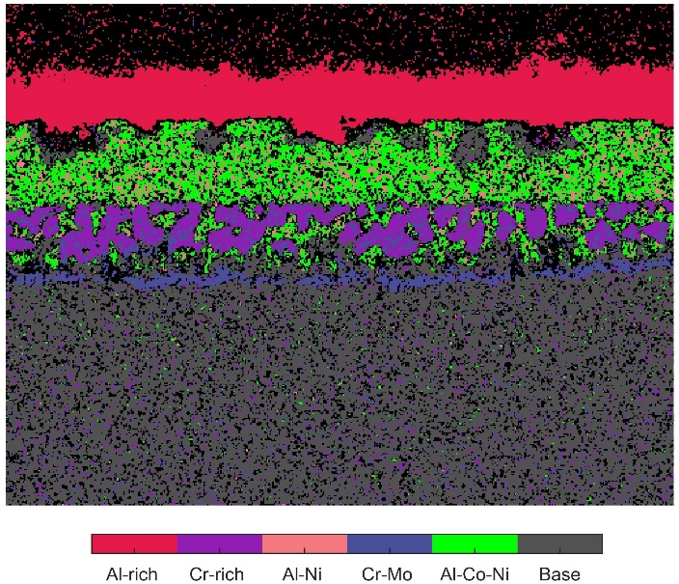
Press the “Threshold Mapping” button to create threshold maps. See the notes section of this page for directions.
Notes:
Only designed to work for at% or wt%, not counts
Any unchecked boxes are ignored
You must manually update the figure by clicking the “update figure” button
The base can be re-named and colored by clicking the Re(name/color) base button.
The base elements are those that make up the composition of your base
The program will look for pixels with combinations of these elements within the specific thresholds under the “Base Elements Thresholds” column.
For single element thresholds, the program looks for pixels between the threshold percentages and plots them their color
i.e. In the image, the program looks for pixels between 35 and 100% for Al and 35 and 100% for Cr
For binary and ternary combination thresholds, all combinations of elements will be analyzed and plotted if pixels contain elements that fall within the required element ranges
For example, binary pixels of Al-Ni will be plotted if a pixel contains Al between 5-100% and Ni between 50-100% (inclusive)
Ternary pixels of Al-Co-Ni will be plotted if a pixel contains between 5-100% Al, 5-100% Co and 50-100% Ni
The program will plot ternary pixels above binary which are above singular elements (i.e. regions that are Al-rich and have Al-Ni will only show up as Al-Ni. Regions that have Al-Ni and Al-Co-Ni will only show up as Al-Co-Ni)
All possible binary or ternary combinations are considered by the program
If you do not want them to all be considered, you can uncheck the box for that combination at the bottom
You can rename or recolor the single, binary, and ternary combinations in a variety of pre-defined ways with the “re(name/color) single/binary/ternary” buttons
The figures and all percentages are saved in the “coloredmaps” folder, in addition to the hex colors of the element or element combos in the figure.

Slide 15
Notes
If you do not like the color scheme of the EDS maps or profile lines, you can alter them by altering the “ElementMasterList” file in the program.
If your element(s) are not yet listed in the master list, you will need to add them. Please contact us so we can continue to build up a master library.
The maximum allowable number of ROIs to plot is twenty (20). This is arbitrary, but would be very cluttered if exceeded.
When “Choose Elements” is selected, the numbers from all of the elements are used in the analysis, but only the selected elements will be displayed in the graphs. I.e., no re-normalization is performed.

Slide 16
Contacts for questions
Joseph Kern
email: jkern34@wisc.edu
David Grierson
email: dsgrierson@gmail.com

